Slide 1
Developing with vtk.js

Slide 2



Acknowledgments
Presented By:
Forrest Li (Kitware)
Contributors:
Forrest Li (Kitware)
Trinity Urban (MGH and OHIF)
Steve Pieper (Isomics)
Erik Ziegler (OHIF)
Gordon J. Harris (MGH and OHIF)
James A. Petts (OHIF)
Danny Brown (OHIF)
Stephen Aylward (Kitware)

Slide 3
Funding Sources
VTK.js / Kitware
NIH NINDS R44NS081792
NIH NINDS R42NS086295
NIH NIBIB and NIGMS R01EB021396
NIH NIBIB R01EB014955
Isomics
NIH P41 EB015902
OHIF
NIH U24 CA199460

Slide 4
Course Outline
Introduction to vtk.js and OHIF
Starting a vtk.js project
vtk.js: Architecture, itk.js, widgets, and more
OHIF + vtk.js integration
Advanced vtk.js: WebGL and GLSL

Slide 5




Requirements (basic)
A modern web browser that supports WebGL
Don’t know? Test it out here: https://get.webgl.org/
Good graphics card is preferred
A text editor
WebGL2 ✓
(recommended)
WebGL 1 ✗
(not recommended)

Slide 6


Requirements (development)
node.js (https://nodejs.org/en/)
npm (in node.js install) or yarn (https://yarnpkg.com/en/)
A terminal emulator
Familiarity with working in a shell/command line
Familiarity with browser devtools

Slide 7
Source Files for this Demo
Find them here: https://github.com/KitwareMedical/vtk.js-examples

Slide 8
The super simple example
Only browser + text editor needed

Slide 9
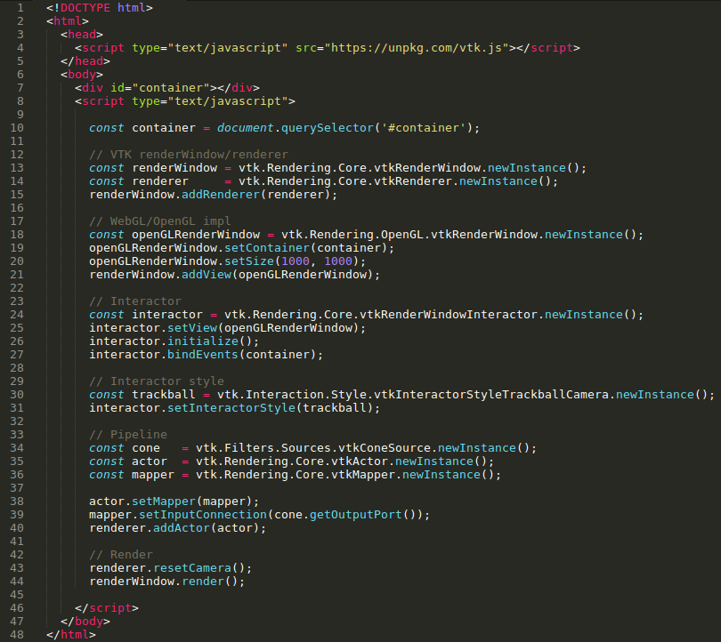
🌟 Only a single
HTML file needed!
File: standalone.html

Slide 10
Import VTK.js

Slide 11
Set up the VTK.js RenderWindow and Renderer

Slide 12
Attach WebGL RenderWindow implementation

Slide 13
Attach interactive trackball controls

Slide 14
Construct our rendering pipeline for a cone

Slide 15
Center camera on cone and trigger the render pipeline

Slide 16

Super simple example
Great for one-off demos
Only need a browser!
No need to pull in node.js/npm/entire development ecosystem
Ease of prototyping
💡 Exercises
Use a different surface source, like vtkCylinderSource, vtkSphereSource, or vtkPlaneSource
Modify some properties of the sources! e.g. cone.setHeight(3.0)

Slide 17
Project Creation Example
node + npm + everything else

Slide 18
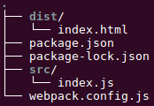
Project Creation: Application Structure
Example application structure
We will make these files as we go through the example
src/: source code
dist/: final bundled code
See the examples for final project

Slide 19
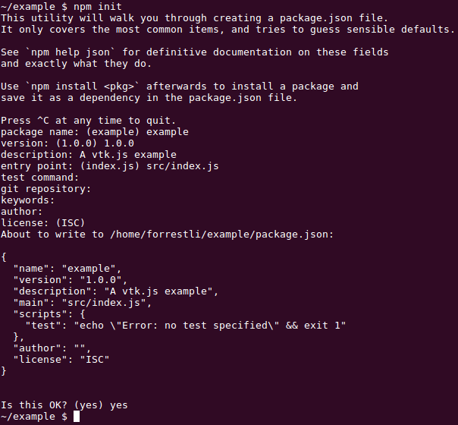
Project Creation
$ npm init

Slide 20
Installing tooling + dependencies
$ npm install --save vtk.js $ npm install --save-dev kw-web-suite
Brings in:
webpack
babel
eslint
prettier
webpack loaders (css, shaders, etc.)
webpack-dev-server
...and more

Slide 21
Creating initial files
Main javascript entry point: src/index.js
Browser entry point: dist/index.html
Webpack build configuration: webpack.config.js

Slide 22
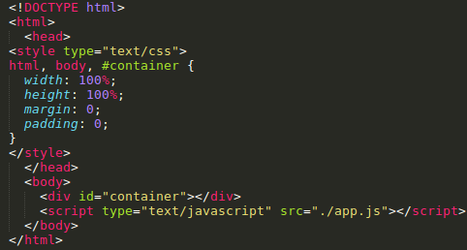
Creating files: dist/index.html

Slide 23
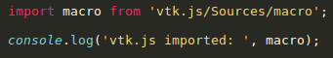
Creating files: src/index.js
Start with a simple import to verify the build worked

Slide 24
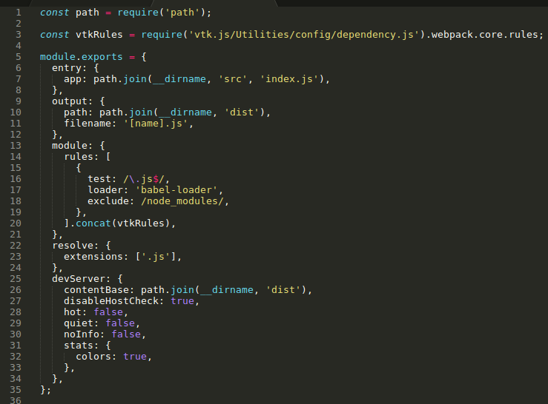
Creating files: webpack.config.js

Slide 25
Creating files: webpack.config.js
vtk.js webpack rules required

Slide 26
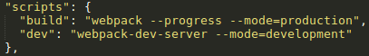
Building our example
Two ways:
npx webpack --progress
Requires installing “npx”: npm install -g npx
npm run build or npm run dev
Requires the following changes to package.json:

Slide 27
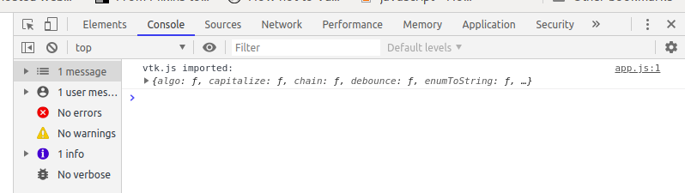
Build results
You should now have a file: dist/app.js
Open index.html in your browser, open devtools (F12 on most browsers):
Success!

Slide 28
Cone Example: revisited
Let’s “rewrite” our old code

Slide 29
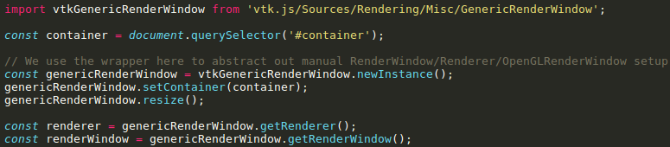
Rewriting our Cone Example
vtkGenericRenderWindow does all of the setup for the RenderWindow, Renderer, and Interactor.

Slide 30
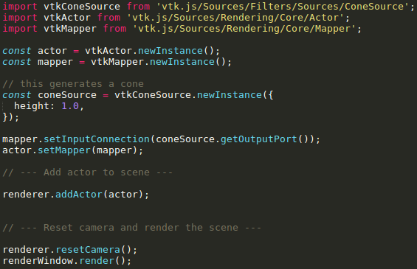
Rewriting our Cone Example

Slide 31

Rewriting our Cone Example
Example source file: vtk.js-examples/cone.js

Slide 32
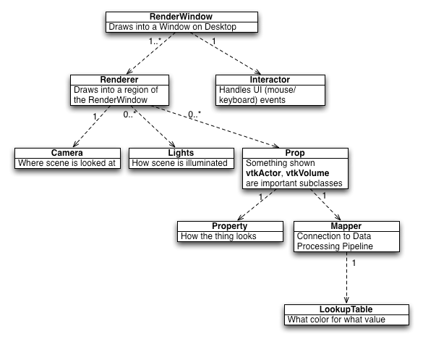
Explanation: Rendering Pipeline

Slide 33
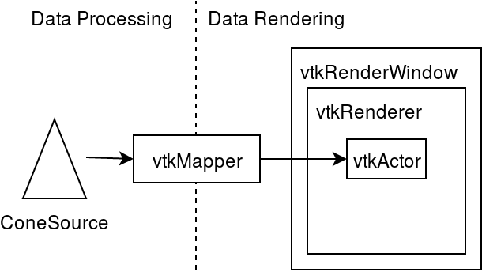
Explanation: Rendering Pipeline
ConeSource supplies data
Data goes through Mapper
Mapper is attached to Actor
Renderer holds many Actors
RenderWindow holds many Renderers

Slide 34
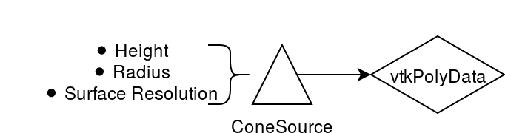
Examining ConeSource
vtkConeSource is a VTK filter
Algorithm that outputs vtkPolyData
A collection of vertices, lines, and surfaces
A basic vtk.js datatype
ConeSource algorithm: 0 inputs, 1 output

Slide 35
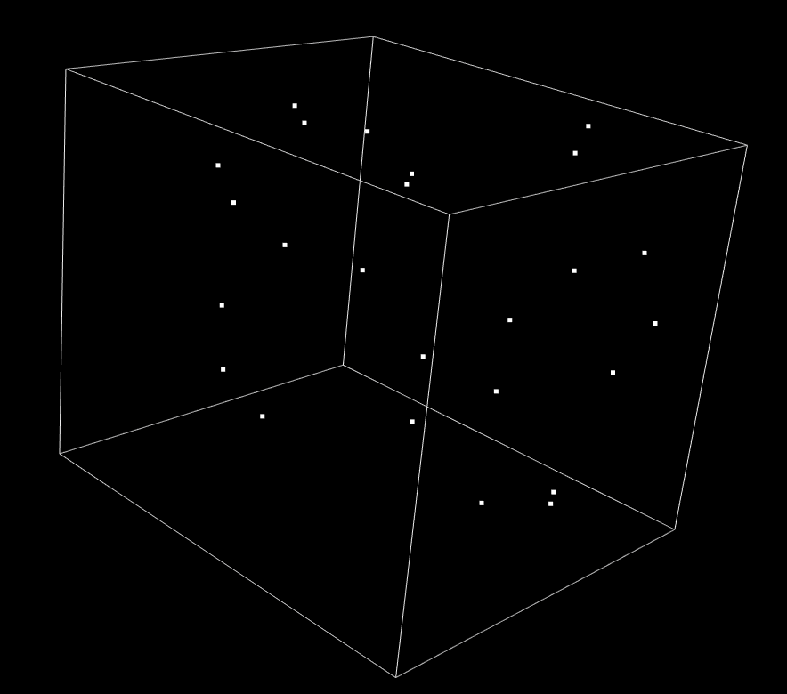
VTK.js Filters: Example
Simple example: vtkOutlineFilter
vtkOutlineFilter transforms input PolyData into an outline box

Slide 36
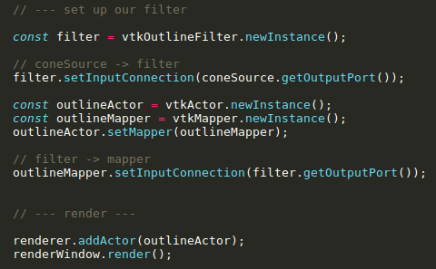
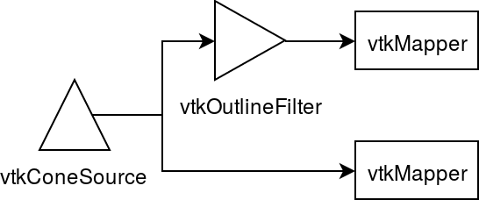
VTK Filters: Example

Slide 37
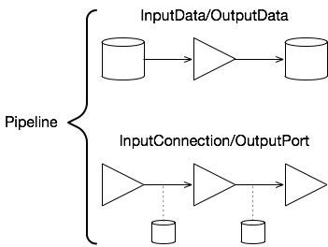
VTK Filters: Pipelines
InputData/OutputData
Static: need to call getOutputData() to get updated data
InputConnection/OutputPort
Reactive: getting the output data of a chain of filters will fetch the latest data given the existing parameters
Data can go through multiple pipelines

Slide 38
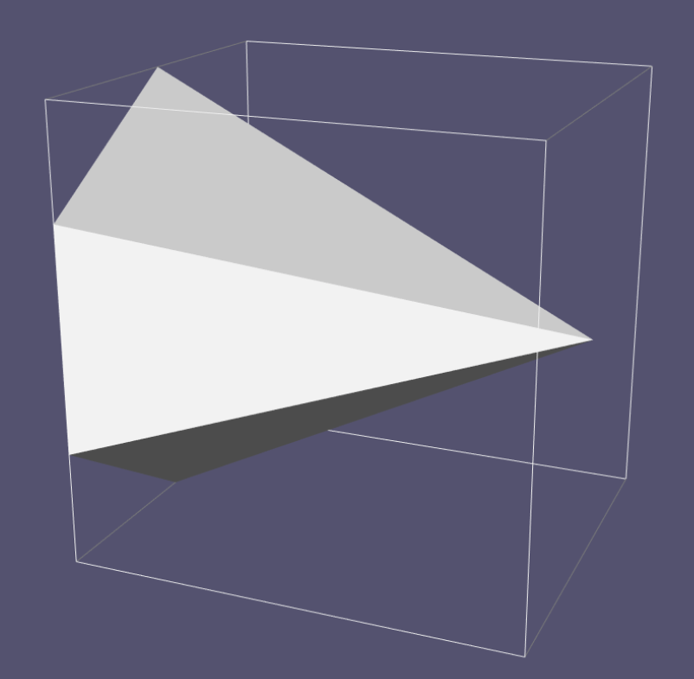
VTK Filters: Example Result
Example source file: vtk.js-examples/cone-filter.js

Slide 39
Volumes and Images
3D volumes and 2D slices

Slide 40
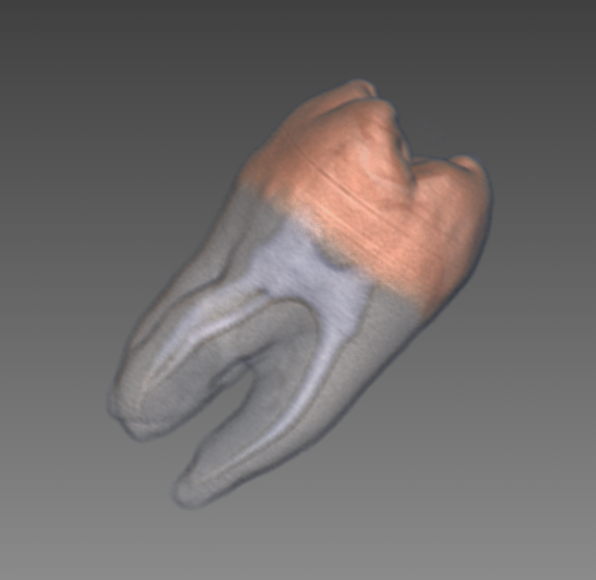
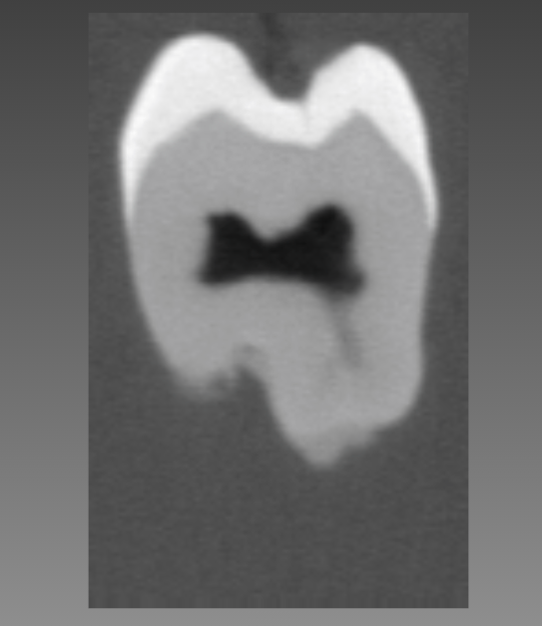
Volume and Slice Rendering
3D volumes rendered in scene
Including oriented images!
Color Transfer Functions
Opacity
Slicing
Loading remote datasets

Slide 41
Volume Rendering Example
Three steps:
Setting up the volume rendering pipeline
Loading a remote dataset
Rendering the volume

Slide 42
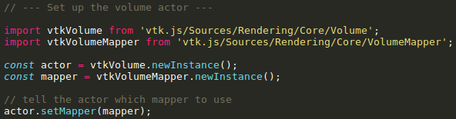
Volume Rendering Pipeline
Set up the vtkVolume and vtkVolumeMapper
Very similar to the cone setup
What data goes into the mapper?

Slide 43
Loading a Remote Dataset
vtk.js/Sources/IO/Core/HttpDataSetReader
Loads a custom vtk.js-specific file format
Data is automatically loaded into a polydata or image
Example
Browser Fetch API with I/O readers
Downloads raw data from an endpoint
Must manually load that data into usable vtk.js polydata or image
XMLImageDataReader, XMLPolyDataReader, itk.js, etc.
Alternative for older browsers: XMLHttpRequest API

Slide 44
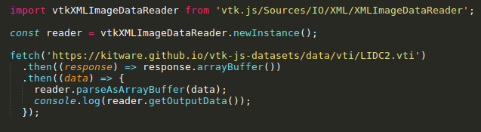
Fetch Example
💡 Throughout these examples, feel free to try fetching and rendering your own data! Make sure the data is CORS accessible.
https://developer.mozilla.org/en-US/docs/Web/HTTP/CORS

Slide 45
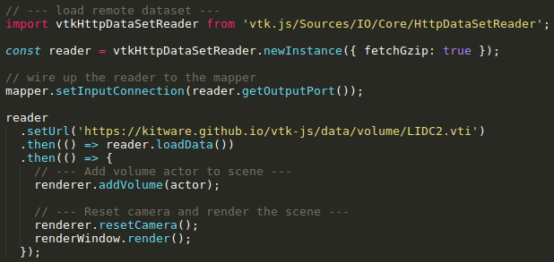
Loading a Remote Volume
HttpDataSetReader is an algorithm that outputs a dataset

Slide 46
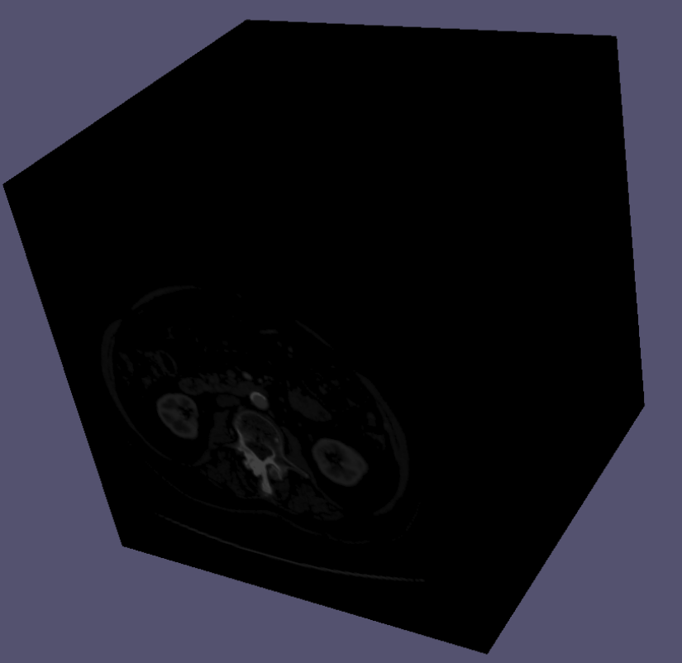
Volume Rendering: 1st result
Black/grey/white
No opacity
Not terribly useful - cannot see Inside
Source file: volume.js

Slide 47
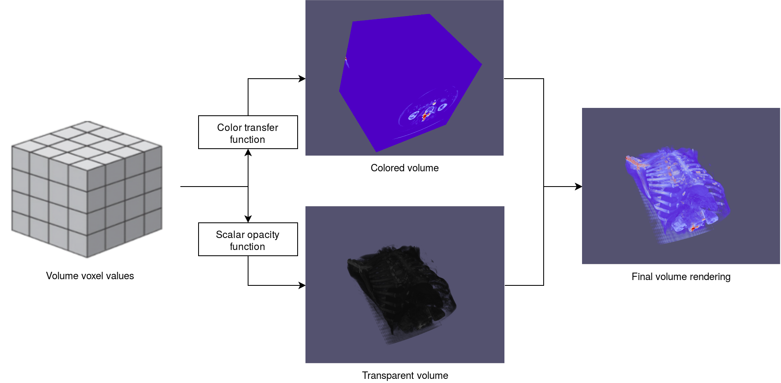
Volume Rendering: Opacity and Color
Opacity function: determines which voxels are transparent
Color transfer function: Determines which voxels map to what color

Slide 48
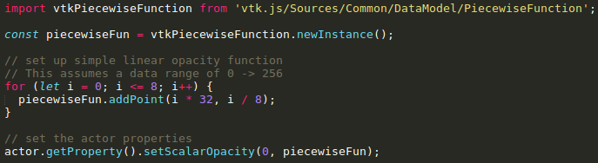
Volume Rendering: Opacity
Create a vtkPiecewiseFunction
Linear opacity function maps [0, 256] to [0, 1]
Actor properties: Opacity, color, lighting, etc.

Slide 49
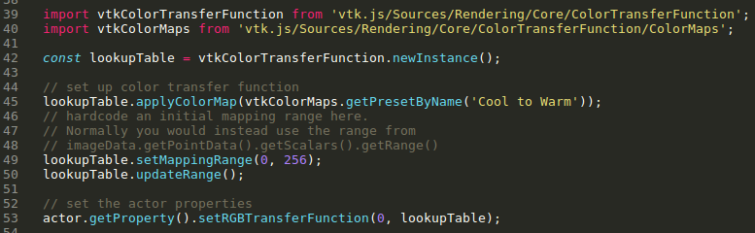
Volume Rendering: Color Transfer Function
Create a vtkColorTransferFunction
Apply a colormap, or set points manually
Cool to Warm, Matlab colors, ERDC colors, etc.
Set mapping range to be volume data range

Slide 50
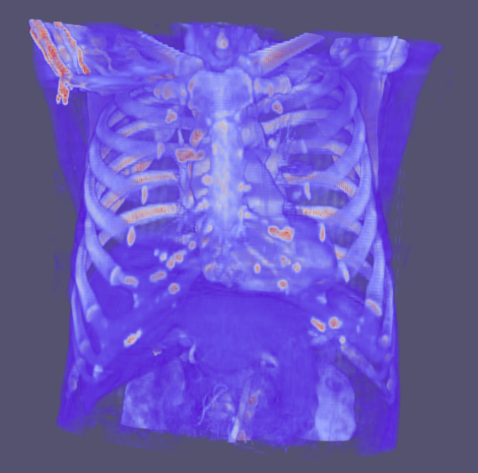
Volume Rendering: 2nd result
Pixels close to 0 are now transparent
Pixels are mapped according to the colormap “Warm to Cool”
Can see internal volume structures
Source file: volume-transfer.js

Slide 51
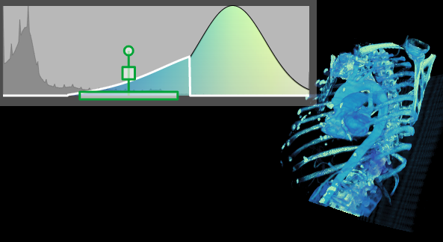
Piecewise Gaussian Widget
Interactive opacity function editing
Multiple Gaussian functions
Check it out: https://kitware.github.io/vtk-js/examples/PiecewiseGaussianWidget.html

Slide 52
Volume Rendering
MPR
Max, Min, Avg Intensity Projection
Multiple component volumes
Interpolation types
💡 Exercises!
Change the scalar opacity function. More advanced: use vtkPiecewiseGaussianWidget
Change up the color transfer function with a different preset: All presets
Try rendering an oriented image dataset

Slide 53
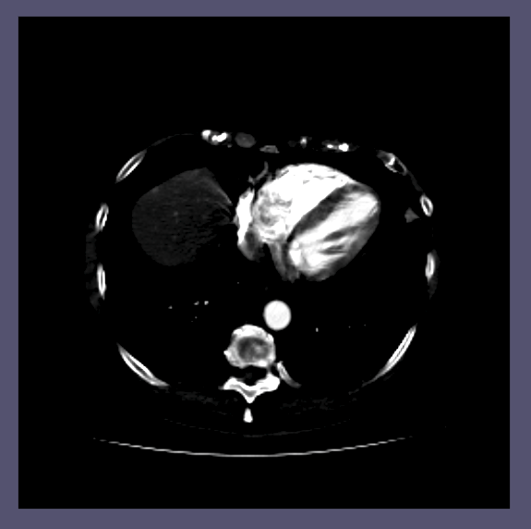
Volume Slicing
vtkVolume -> vtkImageSlice
vtkVolumeMapper -> vtkImageMapper
Parallel camera projection
2D image interactor
window/level
slicing

Slide 54
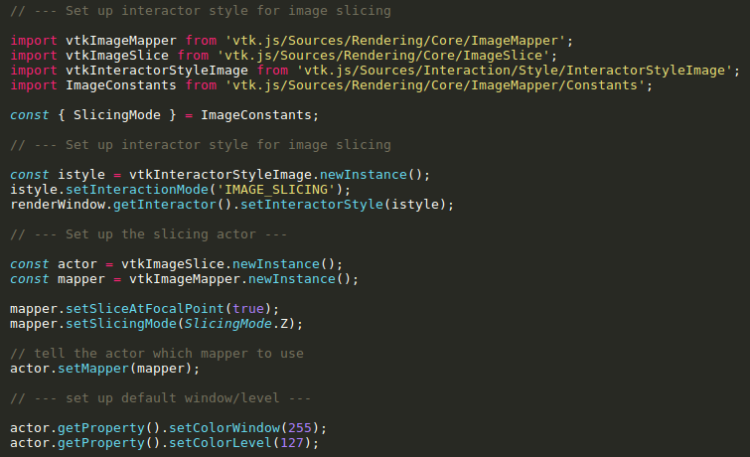
Volume Slicing

Slide 55
Volume Slicing
Use image slicing interactivity (slice scroll and mouse window/level)

Slide 56
Volume Slicing
Need to set slice at focal point

Slide 57
Volume Slicing
Sets default window/level

Slide 58
Volume Slicing
Play around with the mouse for window/level controls
Scroll through slices with mouse wheel or trackpad scrolling
Source file: image-slicing.js

Slide 59
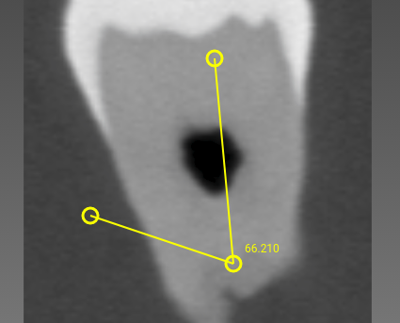
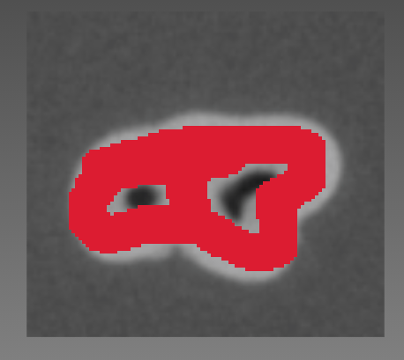
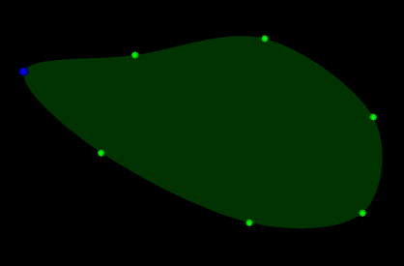
Widgets and Interactions
Add lines and controls to a scene
Paint or contour an image
Place landmarks
Select regions
...and more!

Slide 60
Widget Example: Cropping Widget
Interactive widget to crop a volume
Demonstrates handle and dataset interactions in 2D and 3D
Requires the vtkCropFilter
This performs the actual cropping of the dataset

Slide 61
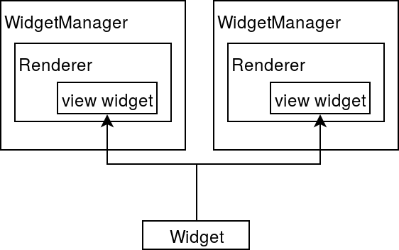
Widgets Overview
Widget Manager
Is associated with a renderer
Manages widgets in that renderer
Widgets
Consists of a widget state and a widget factory
Widgets constructed via factory are bound to renderers
Representations derive from widget state
MVC architecture

Slide 62
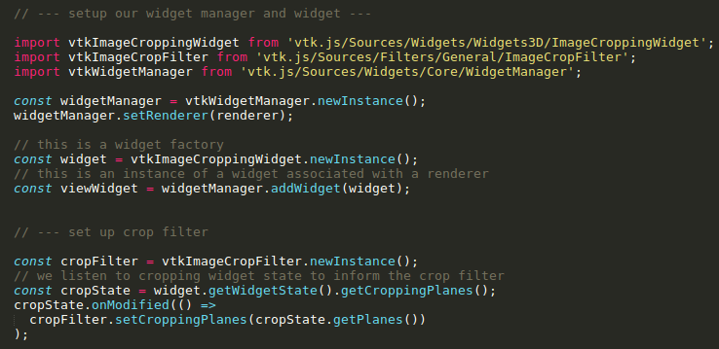
Adding Crop Widget

Slide 63
Adding Crop Widget
Attaches renderer to widget manager

Slide 64
Adding Crop Widget
A view widget is an instance of a widget in a renderer.

Slide 65
Adding Crop Widget
When the crop widget updates, we crop our image.

Slide 66
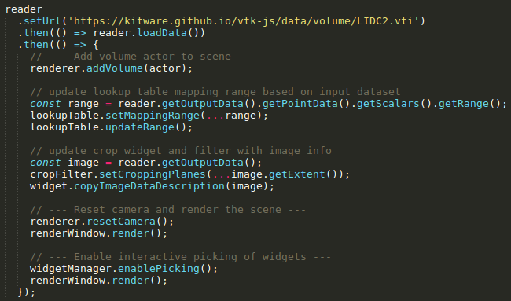
Adding Crop Widget
vtkHttpDataSetReader 🠆 vtkCropFilter 🠆 cropped image
Initialize the crop filter with the volume

Slide 67
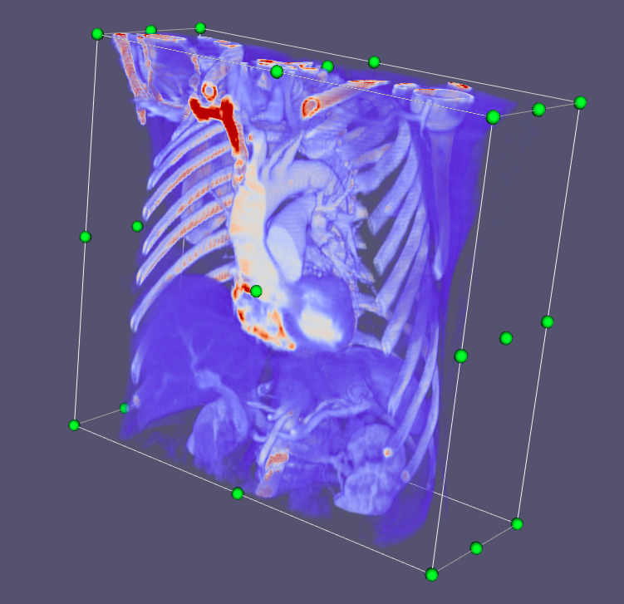
Crop Widget
Crop your volume via the green handles
💡 Check out other vtk.js widgets on the vtk.js examples page.
Play with the widget API by turning off certain handles
Source file: widgets.js

Slide 68
Conclusion
Demonstrated examples for:
Geometry rendering
Filters
Volume rendering
Slice rendering
Interactive widgets
More: https://kitware.github.io/vtk-js/examples/

Slide 69
Next Time
Next course (#3):
Digging into vtk.js: Architecture and more

